Slide 1
Sampling II: Non-Probability Sampling
Wenchao Ma
University of Minnesota

Slide 2
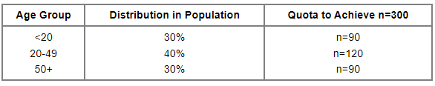
Quota Sampling
Similar to stratified sampling in that we develop non-overlapping groups
Sample a predetermined number of individuals within each group
An example:
Notes:
For example, suppose our desired sample size is n=300, and we wish to ensure that the distribution of subjects' ages in the sample is similar to that in the population. We know from census data that approximately 30% of the population are under age 20; 40% are between 20 and 49; and 30% are 50 years of age and older. We would then sample n=90 persons under age 20, n=120 between the ages of 20 and 49 and n=90 who are 50 years of age and older.
Quota sampling is different from stratified sampling, because in a stratified sample individuals within each stratum are selected at random. Quota sampling achieves a representative age distribution, but it isn't a random sample, because the sampling frame is unknown. Therefore, the sample may not be representative of the population.

Slide 3
Quota Sampling
Not the same as a stratified sample
Still a non-probability sample
Improves variation within the sample to reflect some aspect(s) of the population
Still subject to selection bias & subjectivity

Slide 4
Purposive Sampling
Also called judgmental sampling
Participants chosen based on their specialized knowledge of the subject area

Slide 5
Purposive Sampling
Not a probability sample
Sample drawn is not representative of the larger population
Cannot estimate sampling error or bias

Slide 6
An Example of Purposive Sampling: Extreme case sampling
focus on cases that are special or unusual, typically in the sense that the cases highlight notable outcomes, failures or successes.
A researcher wants to collect feedback from students on a new instructional plan.
She pick some students who are less satisfied to gain more insights.
Notes:
extreme (or deviant) cases are useful because they often provide significant insight into a particular phenomenon, which can act as lessons (or cases of best practice) that guide future research and practice.

Slide 7
Convenience Samples
Elements selected because they are easy to include, or they are available
Common problem:
Respondents will have similar characteristics because they are part of the researcher’s network

Slide 8
Convenience Samples
Least-scientific form of sampling
Other names:
Availability sampling
Haphazard sampling
Notes:
Convenience sampling involves using respondents who are “convenient” to the researcher. There is no pattern whatsoever in acquiring these respondents—they may be recruited merely asking people who are present in the street, in a public building, or in a workplace, for example.

Slide 9
Convenience Samples
Interpret results with extreme caution
No reason to believe the sample is representative of the population

Slide 10
Sampling Hard-to-Find or Hidden Populations
Some populations are hard to sample
Size & locations are not known
Population is marginalized or stigmatized
Examples?
Homeless
drug users
Others?

Slide 11

Snowball Sampling
Other names:
Chain sampling
Chain referral
A member of the sample refers the researcher to others who fall within the population
These members refer others
These members refer others
And so on…

Slide 12
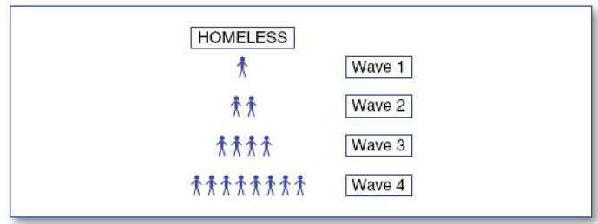
Snowball Sampling

Slide 13
What are problems that come to mind with snowball sampling?

Slide 14
Selection Bias
Whoever is included as the Wave 1 recruit can have a strong influence on the rest of the sample

Slide 15
Minimizing bias in snowball sampling
Use Wave 1 recruits from different sub-populations
Draw Wave 1 recruits randomly if possible

Slide 16
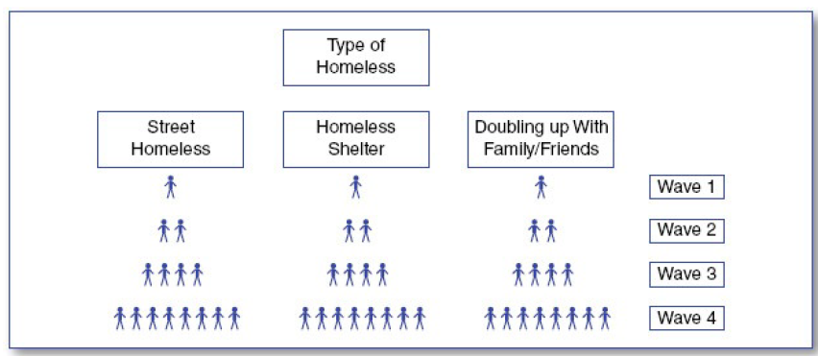

Slide 17
Exercise: Which sampling method is used?
A researcher wants to conduct a survey to study the eating habits of UMN students.
They randomly select 100 students from the list of all enrolled students at the university.
They randomly select four from eight freshman-admitting colleges and then recruit students by advertising at the college buildings.
They go to St. Paul Gym to find students who are interested in this survey.
They go to Dinky town to identify 25 freshman, 25 sophomore, 25 junior and 25 senior undergraduates.

Slide 18
Exercise: Which sampling method is used?
A researcher studying a rare disease starts with a few known patients and asks them to refer other patients they know.
A student conducts a survey on study habits by asking friends and classmates to participate.
A researcher conducts a survey of attitudes of drug users to rehabilitation services. Drug users are recruited by advertising in the local newspaper for potential respondents.

Slide 19
Exercise: Which sampling method is used?
A survey of the attitudes of mothers with children under one year.
Method: interviewers stop likely looking women pushing prams in the street. The number of respondents who fall into different age bands and social classes is strictly controlled.
A survey for children with and without chronic asthma.
Method: the children are selected so that in the sample exactly 50% have chronic asthma and 50% have no asthma. Within each of these groups, the children are randomly selected.

